Slide 1
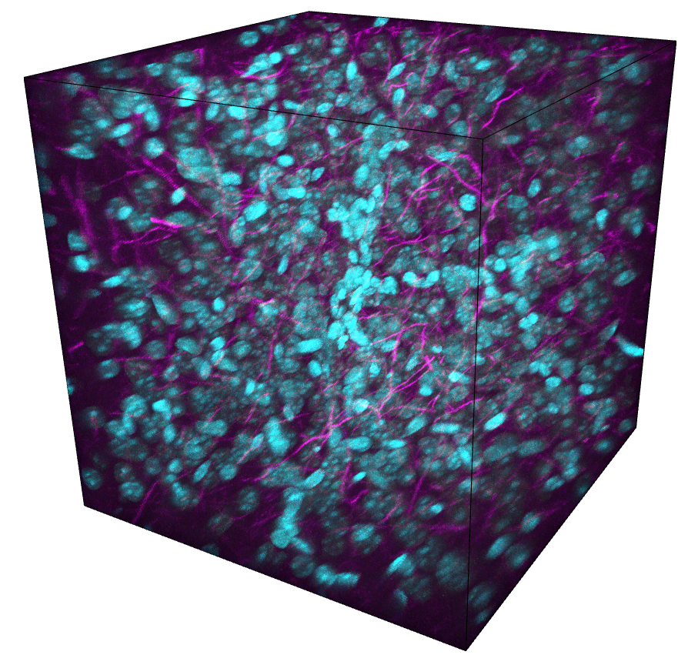
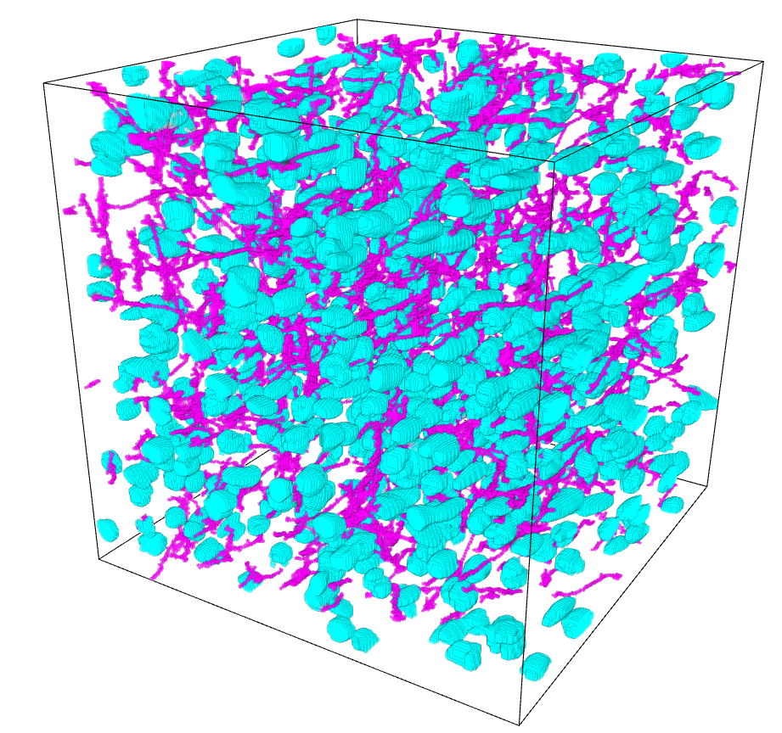
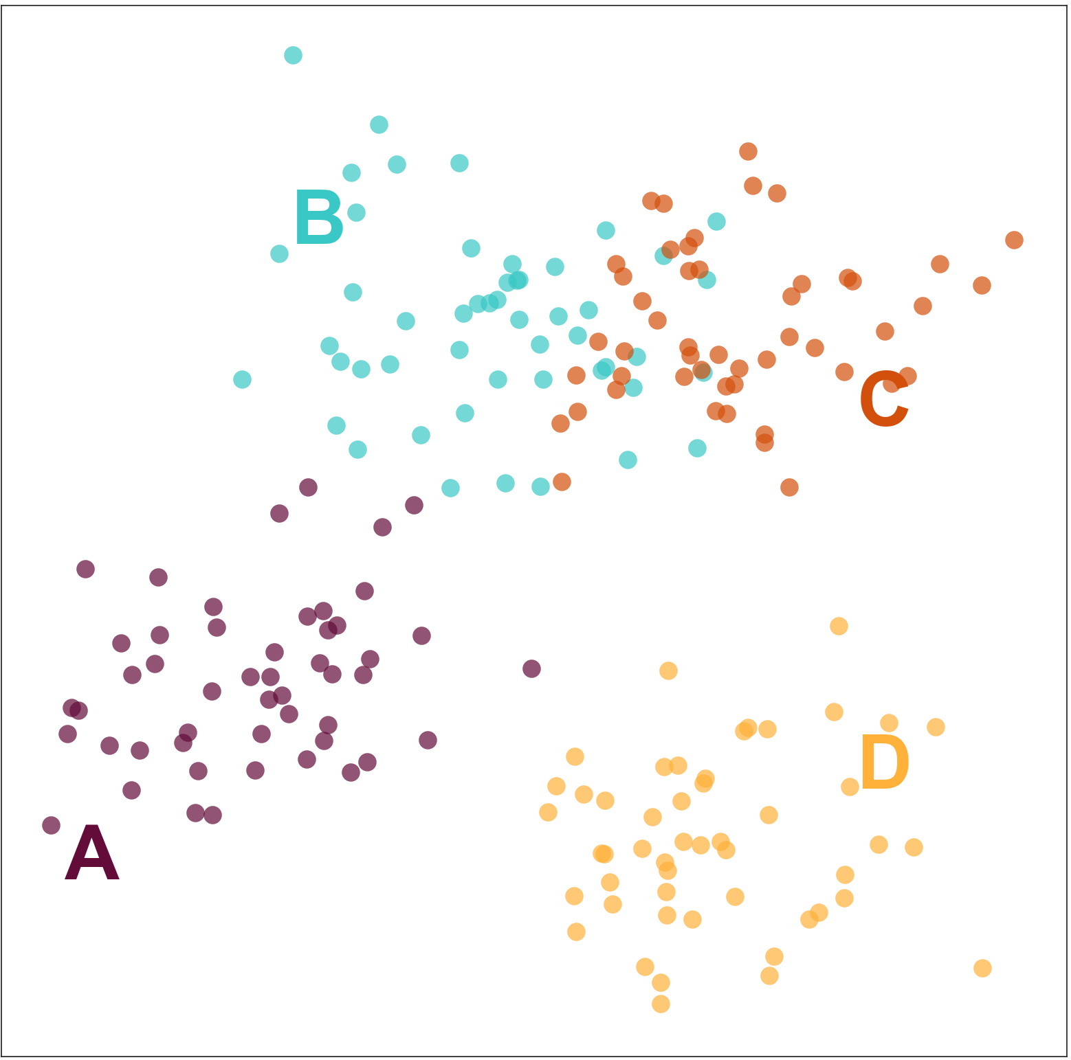
Introduction to image analysis
The course will cover general image analysis principles and basic analysis in ImageJ.
17 April, 2018 - 10 - 3pm
CBO Ground floor computer training room
Delivered by Adam Tyson
(Advanced Image Analyst and Microscopist)
Register now on the
L&D website
training.icr.ac.uk

